Slide 1
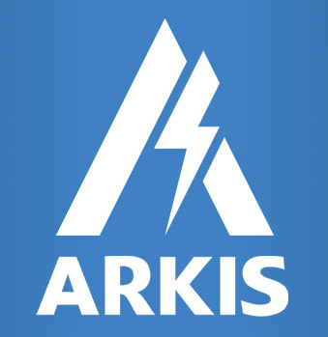
Welcome to

Slide 2

About us
ARKIS
We have the pleasure to introduce ourselves ARKIS Lighting Pvt. Ltd. as a Pvt. Ltd company established in 2017 which strives to become a pioneer in providing international standard lighting solution provider in the field of Home, Industries including pharmaceutical, education and research institute, retail spaces, transport infrastructure, road lighting, mall, area lighting and many more areas.
We at ARKIS use high end technology and smart innovation techniques in improving the wattage usage, luminosity and achieving the main aim of reducing the electricity consumption bills which is always a big concern for all of us as the billing is always on the up-swing which hampers the financial condition for all.
We have a huge cache of products which includes LED bulbs, spotlight, LED light strips, LED lamps etc.
At ARKIS , we are ready to serve all your lightning needs where eco- friendly , dependability, versatility, budget conscious, low maintenance is the main criteria where we excel at all times and ready with all kinds of solution which are tailor made for one’s specific need.
Apart from providing the above scope of work, we also do procurement of LED Light, solar Lights, Electrical switches, electrical and electronic goods. We are also involved in import and export of the same.
In continuation to this, we also provide general and technical consultancy for the related items. We have research and development, design, provision of technical assistance and licenses, consulting and manufacturing system including production, control and quality control and improvement of production lines.

Slide 3

About us
ARKIS
ARKIS Lightings Pvt. Ltd. is a technology conscious company focused on science- based lighting solutions. Drawing from basic roots, the company has a track record of commercializing next generation products targeted for infrastructure, commercial and residential places.
Our understanding and expertise of solid state lighting enables the company to capture the essence of light through minimalist designs that incorporate advanced feature sets.
The material and energy efficiencies achieved through this approach drive the competitive costing and ultimately successful product.
Our hands on experience of the impact of light enable the company to bring in unique products to the market that improves the health and wellness of human, plants and animals.
It is our mission to be a key provider of LED lighting solutions to the marketplace.

Slide 4






Contact us
ARKIS
ARKIS office in India.
Arkis Lightings Pvt. Ltd.
Suite No S01, 2nd Floor, A88,
Sector - 4, Noida - 201301,
Gautam Budh Nagar, UP, India
+91 120-4519505
Mail id - info@arkisglobal.com
Website - www.arkisglobal.com

Slide 5

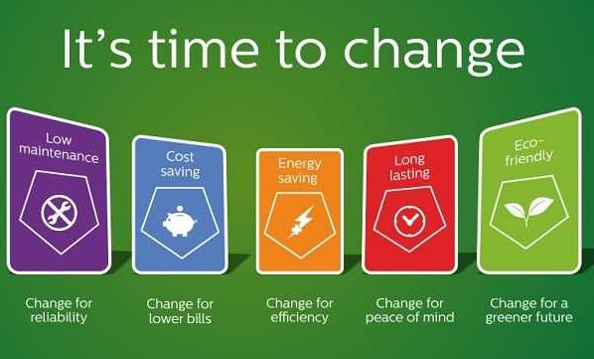
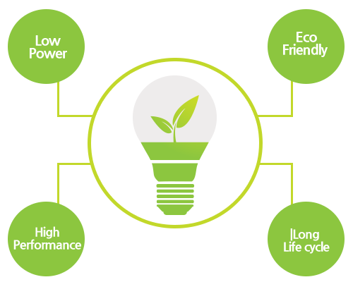
Why LED
ARKIS
The light-emitting diode (LED) is one of today's most energy-efficient and rapidly-developing lighting technologies. Quality LED light bulbs last longer, are more durable, and offer comparable or better light quality than other types of lighting.
Up to 60% Energy Saving Over Traditional Energy Saving Bulb (CFL)
More Then 90% Energy Saving Over Incandescent Bulb
GO GREEN WITH LED
Shop Our LED Bulbs

Slide 6
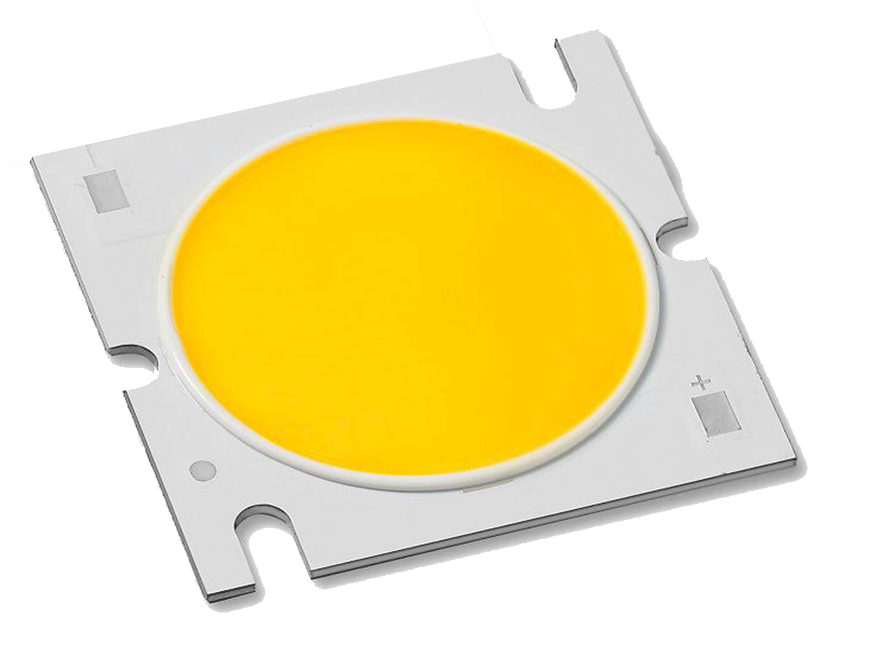
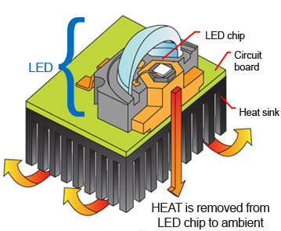
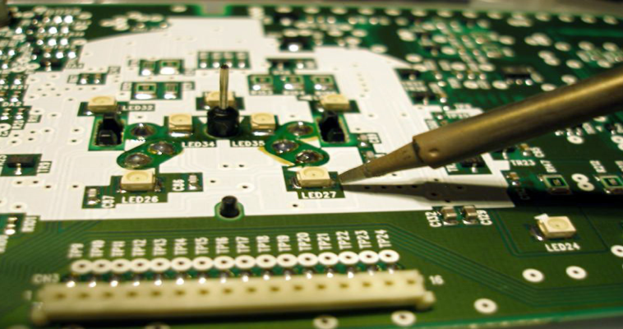
ARKIS
Why ARKIS
Because:
We don’t compromise on product Quality.
We follow National and International product certification as per the requirements
Our product has high lumen efficacy
Standard LED chip being used having LM 80 certification
Housing selected as per Thermal dissipation standard.
Driver efficiency is optimum
We use high Power Factor driver > 0.9 with <20% THD (Total Harmonic Distortion).
We use high surge with stand protection.
ARKIS have all the safety protection.
Open circuit voltage.
Short circuit protection.
Reverse polarity.
Under voltage protection.
Over voltage protection.
Over temp. protection.

Slide 7

ARKIS
Our Product range
ARKIS is a part of the ARKIS LIGHTING PVT. LTD, a group leading the industry in electrical sector. ARKIS is synonymous with innovation and quality products, services; it ranks highest, especially in the LED lighting products.
Indoor – Household & Office Lighting
Industrial Lighting
Outdoor Lighting
Decorative Lighting
Start Greening Your Home Or Office With LED Lights Today!

Slide 8
ARKIS
Product Portfolio
Applications :
Features :
Test Reports :
Offices
Malls
Showrooms
Residential
Conference rooms
Parking areas
Common areas
Hospitals
Wellness
Sustainable and aesthetically designed.
More than 60% energy saving in comparison with incandescent & CFL lamp.
Special thermal pad back pf PCB for good heat distribution.
Environmentally friendly-contains no mercury or other hazardous materials.
Appropriate unify glare ratio.
Driver Efficiency : >85
Power Factor : >0.9
CRI : >80
Efficacy : >90 Lumen per watt
Operating Temperature Range : -5 to 50 degree centigrade.
Over voltage protection : Provided
Off state power : Zero
BIS-Bulb
BIS-Tube Light
BIS-Panel Light

Slide 9
ARKIS
Product Portfolio
Indoor – Household & Office Lighting

Slide 10
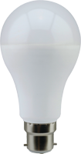
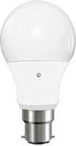
ARKIS
Product Portfolio
Indoor – Household & Office Lighting :

Slide 11
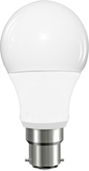

ARKIS
Product Portfolio
Indoor – Household & Office Lighting :

Slide 12
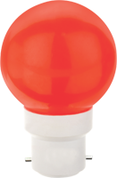

ARKIS
Product Portfolio
Indoor – Household & Office Lighting :

Slide 13
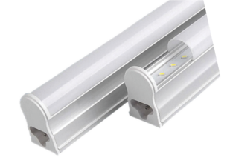

ARKIS
Product Portfolio
Indoor – Household & Office Lighting :

Slide 14

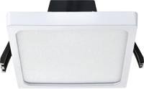
ARKIS
Product Portfolio
Indoor – Household & Office Lighting :

Slide 15

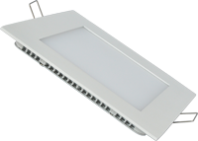
ARKIS
Product Portfolio
Indoor – Household & Office Lighting :

Slide 16

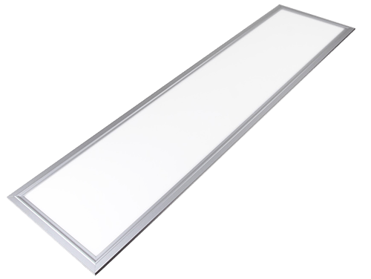
ARKIS
Product Portfolio
Indoor – Household & Office Lighting :

Slide 17

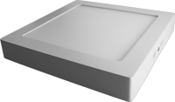
ARKIS
Product Portfolio
Indoor – Household & Office Lighting :

Slide 18


ARKIS
Product Portfolio
Indoor – Household & Office Lighting :

Slide 19
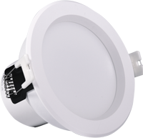
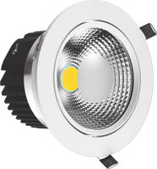
ARKIS
Product Portfolio
Indoor – Household & Office Lighting :

Slide 20
ARKIS
Product Portfolio
Indoor – Household & Office Lighting :

Slide 21
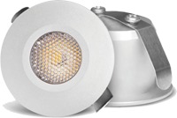
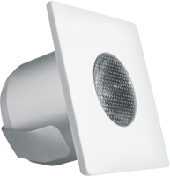
ARKIS
Product Portfolio
Indoor – Household & Office Lighting :

Slide 22
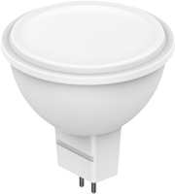
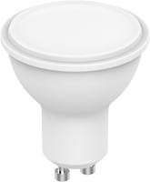
ARKIS
Product Portfolio
Indoor – Household & Office Lighting :

Slide 23
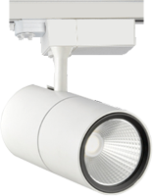
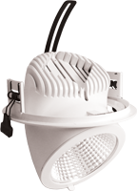
ARKIS
Product Portfolio
Indoor – Household & Office Lighting :

Slide 24

ARKIS
Product Portfolio
Indoor – Household & Office Lighting :

Slide 25
ARKIS
Product Portfolio
Industrial & Outdoor Lighting

Slide 26
ARKIS
Product Portfolio
Applications :
Features :
Test Reports :
Roadways
City Streets
Walkways
Residential Streets
Parking lots / Campus
Exhibition hall
Shopping mall
Stadium / Garden
Sustainable design.
Use of recyclable corrosion resistant materials.
Special thermal pad back pf PCB for good heat distribution.
Environmentally friendly-contains no mercury or other hazardous materials.
5kVA surge protection.
Driver Efficiency : >90
Power Factor : >0.9
CRI : >70
Efficacy : >100 Lumen per watt
Operating Temperature Range : -5 to 50 degree centigrade.
4 bolt mounting for better stability and vibration resistance
In built hi-low cut especially for Indian power conditions
LM-79
LM-80
TM-21
THD

Slide 27
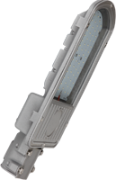
ARKIS
Product Portfolio
Outdoor Lighting :

Slide 28
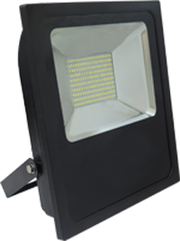
ARKIS
Product Portfolio
Industrial Lighting :

Slide 29
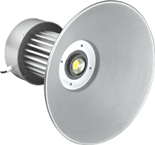
ARKIS
Product Portfolio
Industrial Lighting :

Slide 30
ARKIS
Product Portfolio
Decorative Lighting

Slide 31
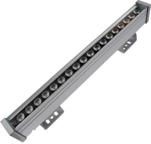
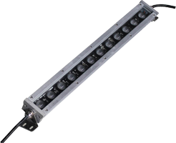
ARKIS
Product Portfolio
Decorative Lighting :

Slide 32
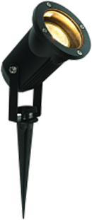
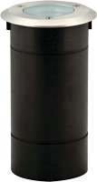
ARKIS
Product Portfolio
Decorative Lighting :

Slide 33
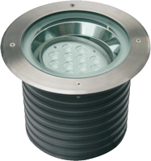
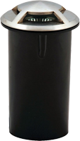
ARKIS
Product Portfolio
Decorative Lighting :

Slide 34
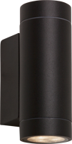
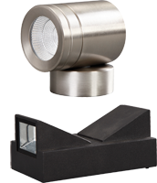
ARKIS
Product Portfolio
Decorative Lighting :

Slide 35

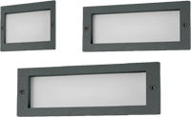

ARKIS
Product Portfolio
Decorative Lighting :

Slide 36
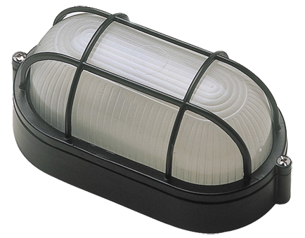

ARKIS
Product Portfolio
Decorative Lighting :

Slide 37
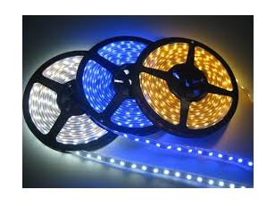
ARKIS
Product Portfolio
Decorative Lighting :

Slide 38
ARKIS
Product Portfolio
Decorative Lighting :

Slide 39


ARKIS
Thanks & Regard's
Team Arkis

